Slide 1
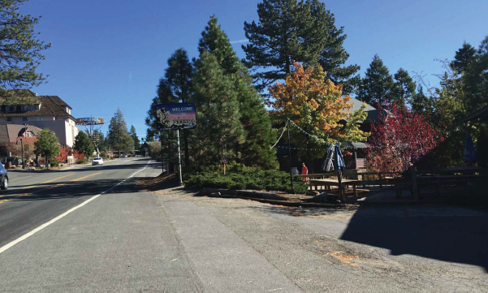
WPVAR-0007 IZAKAYA TAHOE
Washoe County Board of Adjustment
April 5, 2018

Slide 2
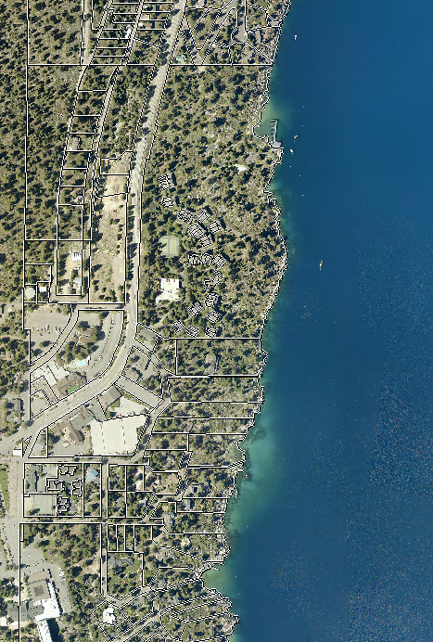
Site Plan
Vicinity Map
Address: 2 North Lake Ave.
Located along the State line in Crystal Bay
Subject Property
St. Route 28
Cal-Neva Rd

Slide 3
Overview
Reduce Font Yard Setback from 20’ to 0’ along Stateline Rd.
Reduce Front Yard Setback from 20’ to 8’ along State Route 28.
Reduce Side Yard Setback from 10’ to 3’
To Allow for Construction of an eating – drinking establishment on vacant property

Slide 4
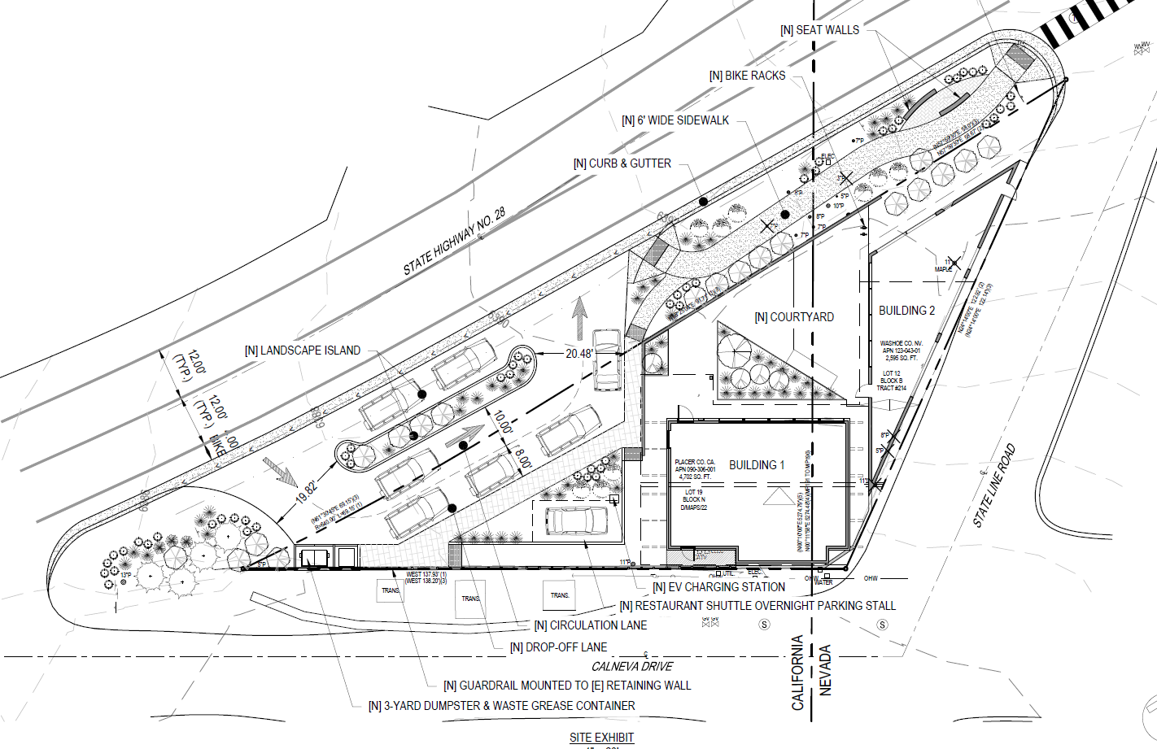
Site Plan
State Line

Slide 5
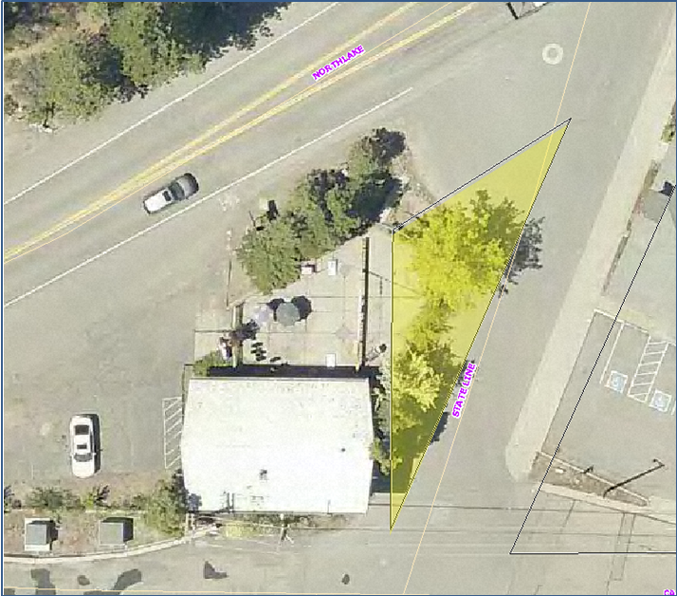
Overhead Photo

Slide 6
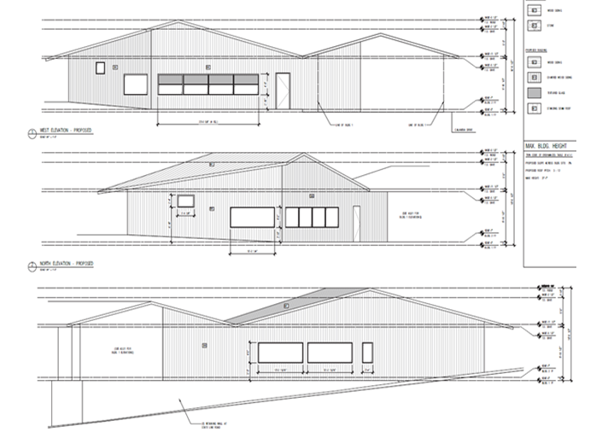
Elevations

Slide 7
Parking
Improve pedestrian access
Public Transportation
Provide Valet Parking
Shuttle Service
Bicycle Parking
Off Street Parking for Employees
Conditions for Parking Agreement(s) and

Slide 8
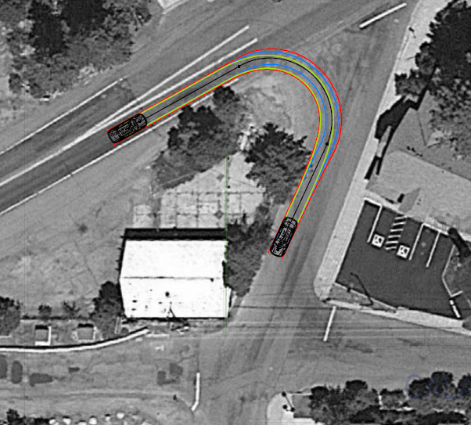
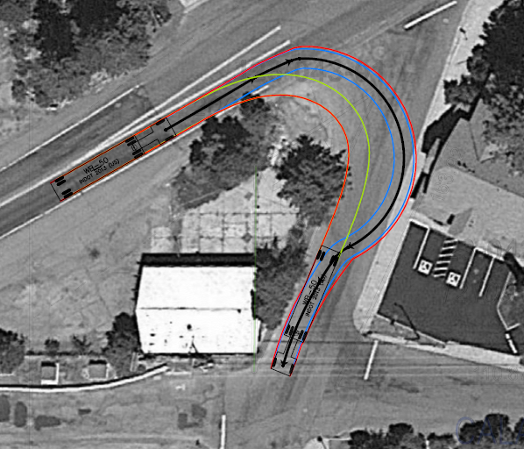
Traffic/Access
Car Right-In Turn
Truck Right-In Turn
Existing Access

Slide 9
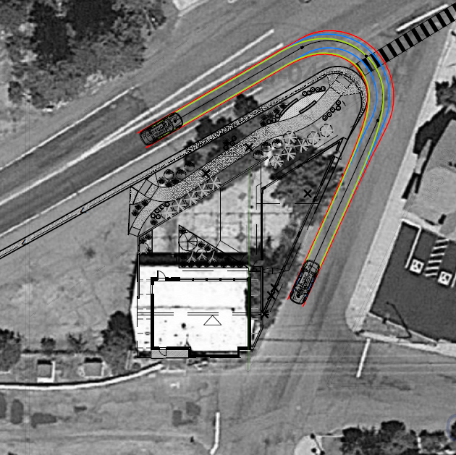
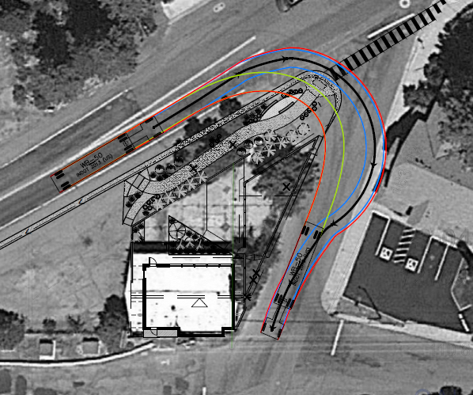
Traffic/Access
Car Right-In Turn
Truck Right-In Turn
Proposed Access

Slide 10
Conditions for Traffic/Parking
Submittal of Traffic Control Plan
Signs, markings, flashing beacons, etc. at pedestrian intersection crossings.
Additional Traffic Study/Information re: turning movements, site distances & traffic and pedestrian safety is required.
NDOT approval(s) for all work in Right of Way.
Parking Agreement(s) and Director’s Modification Required.

Slide 11
Findings
Special Circumstances. Because of the special circumstances applicable to the property, including extraordinary and exceptional situation or condition of the property and/or location of surroundings; the strict application of the regulation results in exceptional and undue hardships;
No Detriment.
No Special Privileges.
Use Authorized.

Slide 12
IVCB CAB
Incline Village/Crystal Bay CAB
Discussed the item at the September 25, 2017 Meeting
Unanimous recommendation for approval

Slide 13
Commenting Agencies
Washoe County Community Service
Planning and Building Division
Planning Section
NDOT
IVGID
Engineering and Capital Projects
Land Development
Traffic/Roads

Slide 14
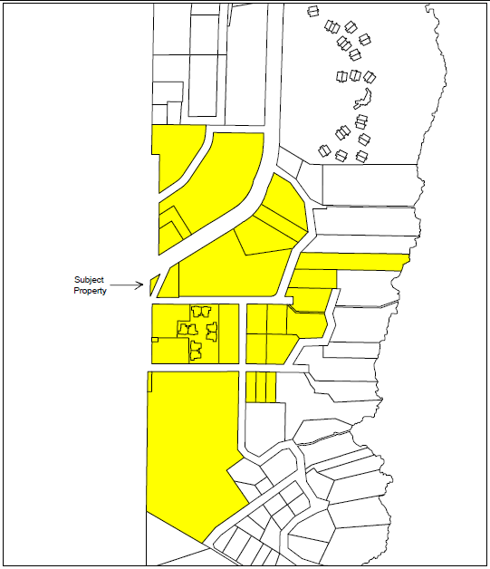
Public Notice
34 Properties Noticed
Minimum 500 foot distancing

Slide 15
Possible Motion for Approval
I move that, after giving reasoned consideration to the information contained in the staff report and information received during the public hearing, the Washoe County Board of Adjustment approve Variance Case Number WPVAR17-0007, with conditions, for Izakaya Tahoe, having made all four findings in accordance with Washoe County Code Section 110.804.25

Slide 16
Possible Motion for Denial
I move that, after giving reasoned consideration to the information contained in the staff report and information received during the public hearing, the Washoe County Board of Adjustment deny Variance Case Number WPVAR17-0007 for Izakaya Tahoe, being unable to make the following required finding in accordance with Washoe County Development Code Section 110.804.25:

